Slide 1
Cogent QC Systems
Enabling Enterprise Quality Control For mortgages, consumer loans, business loans, and more!
ProductionQC System
Complete solution for QA/QC of loan originations
Pre-funding – meet new agency pre-funding audit requirements
Post-funding – complete re-underwriting, including reverifications
EPD – to audit early payment defaults
Compliance, Fraud, Appraisal and Repurchase audit shells available
ServicingQC System
Complete solution for QA/QC of all servicing processes
Meet or exceed agency and regulatory requirements
Automatic rules-based identification of audit populations
Up to 50 audit shells standard; unlimited audits possible
Notes:
- Cogent has two separate platforms for QC: The ProductionQC System for audits of originations, and the ServicingQC System for audits of servicing operations.
Each System can accommodate as many different audits as necessary to meet lender, servicer, agency and regulatory requirements.
The ProductionQC System comes with 3 standard audit shells, for pre-funding, post-funding and EPD audits, but additional audit shells may be added if you have separate units doing compliance, fraud, appraisal, repurchase or other audits.
The ServicingQC System comes with up to 50 standard audit shells, but we also have clients with upwards of 80-100 audit shells.

Slide 2
Cogent Economics – Company Background
Founded in 1991, the mortgage industry’s leading
provider of enterprise quality control software solutions
6 Technology Awards since 2003:
2015: Housing Wire Tech100 – Most Innovative Technology Companies
2011: Lasting Impact Award – Mortgage Technology
2009: Lasting Impact Award - Runner Up – Mortgage Technology
2006: Top 25 Vendors – Mortgage Technology
2005: Top 100 Vendors – Mortgage Technology
2003: “Fix-It” Award – Mortgage Technology
Cogent provides clients with a complete QA/QC solution for
loan originations and loan servicing
Notes:
- Over the past 20 years, Cogent has become recognized as the leading provider of enterprise-level quality control solutions for the mortgage industry.
Cogent introduced statistical quality control to the mortgage industry in 1993, when Fannie, Freddie and HUD agreed to allow a statistically calculated random sample in lieu of the old 10% random sample requirement, for lenders with higher volumes.
Over the next 3 years, we designed and developed a complete audit solution that incorporated our proprietary statistical sampling and reporting methodology, and in 1996 we released the industry’s first Windows-based QC system: The Cogent ProductionQC System.
- Since then, Cogent has continuously improved and expanded our solutions, in partnership with our clients. We’ve received recognition from Mortgage Technology Magazine 5 times since 2003.

Slide 3
Cogent’s Complete QC Solution
State of the Art .NET Technology
Unparalleled functionality and flexibility
Easy to use sampling / auditing / reporting tools
Continuous improvement / free upgrades
Expert Professional / Technical Support
Initial Audit Shell design and system setup
Free Help line for all System users
Ongoing customization available for all clients
Client Education, Training, Community
On-site and online training
Regular live and recorded webinars
Cogent blog
Cogent Quality Symposium
Industry Leadership
QA Principles Workshop
MBA QA Committee
Notes:
Cogent strives to provide clients with a complete QC solution. Our systems not only have the most sophisticated technology, but they’re also very user friendly.
We continuously improve the workflow based on feedback from our clients, and all new updates and releases are provided to clients for no charge, as part of the standard License Agreement.
- We pride ourselves in our tech support, and we also provide a lot of non-technical support for our user community, including monthly web seminars, best practices information on our website and our blog.
- Cogent is also recognized for its industry leadership, being an active member of the MBA’s Quality Assurance Committee for nearly two decades, and conducting QC workshops in conjunction with the MBA.

Slide 4
Cogent Clients The Industry’s Quality Leaders
More than 100 companies have implemented Cogent QC Systems Representative clients include:
US Bank *
PNC Bank *
Ally Bank *
Capital One Bank *
GreenTree Financial *
Nationstar Mortgage *
Union Bank
BMO Harris Bank
SunTrust Bank
TD Bank
Arvest Bank
Webster Bank
Ditech Mortgage
Prospect Mortgage
DHI Mortgage
Ocwen Financial
Urban Financial of America
Homeward Residential
National Mortgage Insurance
* (Both ProductionQC and ServicingQC Systems)
Notes:
- Our clients range from medium to large banks, mortgage companies, and servicers, including many industry leaders. We recently checked a list of the 10 largest originator/servicers, and 6 of them are Cogent clients.
A number of clients have implemented both ProductionQC and ServicingQC, and more are looking to move toward this kind of enterprise approach.
Using Cogent as the QC solution throughout the enterprise ensures that you have the same robust methodology wherever quality or compliance reviews are conducted. It also enables managers to cross-train their staff to work in multiple areas, increasing flexibility in deploying resources.

Slide 5
Automate the Complete QC Workflow
Data Management
Data access (up to 500 fields) via Import File or ETL / population eligibility rules / data export in multiple formats
Sampling
Automatic sample size calculation and selection: statistical, stratified, targeted, manual
Auditing / Reverifications
Records audit findings, comments, notes, ratings, referrals
Sends & tracks letters: order, re-verify, re-disclose
Enables loan assignments, audit tracking, audit sharing
Feedback / Reporting
Web-based Feedback Portal, Audit Status Reports, Audit Findings Reports, Management Reports, Custom Report Writer
Administrator Tools
Customizable user access & user interface, lookup tables, audit question management, chat, message … and more!
Notes:
In each of these Systems, we’ve automated as many of the processes involved in QC and Compliance reviews as possible.
Data Management includes importing the most current production or servicing data, and applying eligibility rules to identify populations from which to sample.
Multiple layers of sampling can be conducted, and sampled loans may be assigned to individual auditors.
Auditors record their findings, comments of any length, notes, ratings and referrals. The system will generate letters of any kind and tracks their sending and receipt via bar codes.
Reporting is comprehensive, including audit status reports, detailed findings reports, reports on feedback, and high level management reports of quality trends and comparisons.
Administrator tools enable customizing each user’s access, managing audit checklists, maintaining watch lists, tracking user activities, chatting, messaging and more – all functionality we’ve added to the System to improve efficiency, flexibility, communication and control.

Slide 6
CogentQC.Net … What’s New!
SQL Database with flexible options to import data or transfer from data source (LOS, data warehouse, ODBC database)
Sampling Wizard to simplify complex sampling strategies
Reports Wizard with expanded parameters, dynamic preview, reports and data exports in multiple formats
Web-based Feedback Portal to record audit feedback, responses and corrective actions, multiple iterations
Enhanced Audit Shell Design enables more features, presents more information, expands user customization
Streamlined User Interface:
Fewer clicks & intervening screens
Single screen parameter selections
Expanded Help with index and search capabilities
Notes:
The new .NET system was developed on the Microsoft .NET platform over a 3 year period, from 2005 to 2008, and it incorporates many changes and improvements from prior versions. The entire code base was rewritten from scratch, and every screen in the application is new.
One of the most popular new features is the web-based feedback functionality, which automates the process of obtaining responses to audit findings and documenting corrective action.
- The new .NET system is evidence of our commitment to continuous improvement and innovation, in partnership with our clients.

Slide 7
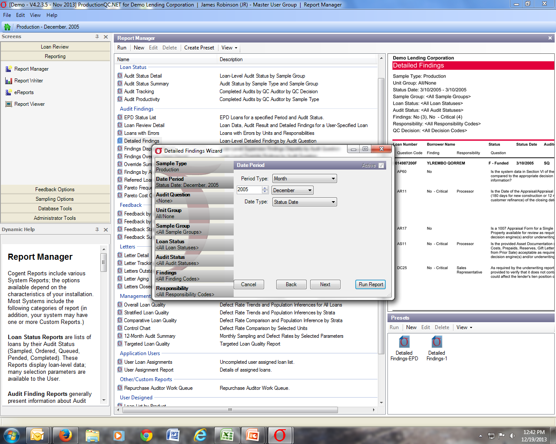
CogentQC.Net
Notes:
The .NET system has a modern, easy to navigate, Outlook style user interface, and the screens can accommodate much more information than previous versions.
For example the Report Manager– all the standard Cogent reports plus any custom reports you create are accessed and generated on a single screen.

Slide 8
Cogent Sampling
“Statistical” random samples: 2% precision / 95% confidence
Report on quality trends and comparisons for each review type
“Stratified” random samples (optional): from selected strata
Report on quality trends and comparisons by strata
“Targeted” samples: user-defined queries, using any data fields
Report on the quality of any targeted unit, segment, individual
“Manual” samples: selected by loan number, borrower, etc.
Report on the quality of individual loans
Notes:
Perhaps the most powerful tools in Cogent QC Systems are the sophisticated sampling and reporting.
- For the first two layers of sampling, Statistical and Stratified, the sample sizes are automatically calculated to achieve your precision and confidence targets. These allow you to create unbiased reports on quality trends and comparisons, with the precision and confidence displayed graphically (report examples to follow).
- The Targeted and Manual sampling allow you to create “intelligently targeted” samples based on risk characteristics, and also to target based on watch lists – which may be new or untested sources or individuals, or those that have had quality issues in the past.

Slide 9
Statistical Sample Size by Population and Defect Rate
Notes:
- This graph demonstrates the statistical sample size calculation built into all Cogent systems.
- It shows that, for a given defect rate, once an annual production or servicing population reaches the 3-5,000 range, the statistical sample no longer has to increase to meet the precision/confidence target. It also shows the important impact of the defect rate on sample size – i.e., twice the defect rate requires about twice the sample size to achieve the same precision. (That’s why tracking your actual defect rates is so important.)
- There are two cost saving benefits from using a properly calculated statistical sample: (1) your sample size does not have to increase over time as your population does, and (2) it can actually decrease if you improve quality.

Slide 10
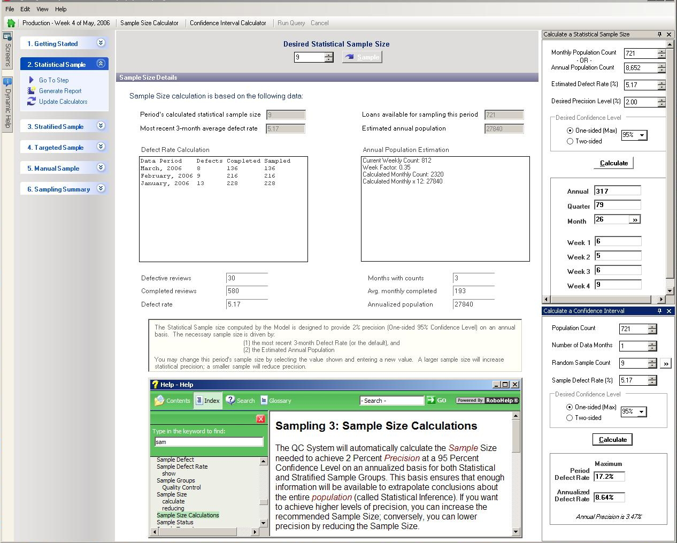
Sampling Wizard
Notes:
The Sampling Wizard guides you through your layers of sampling. The interface is easy to navigate, making your sampling as efficient as possible.
The Wizard displays the data used to calculate the statistical sample size: the population size, the precision/confidence target, and the estimated defect rate.
As shown in the previous graph, the defect rate is critical in properly sizing the statistical sample, and the System is continuously updating this based on the rolling average of your prior 3 audit periods. So meeting your annual precision target is assured, since it is based on your actual results.

Slide 11
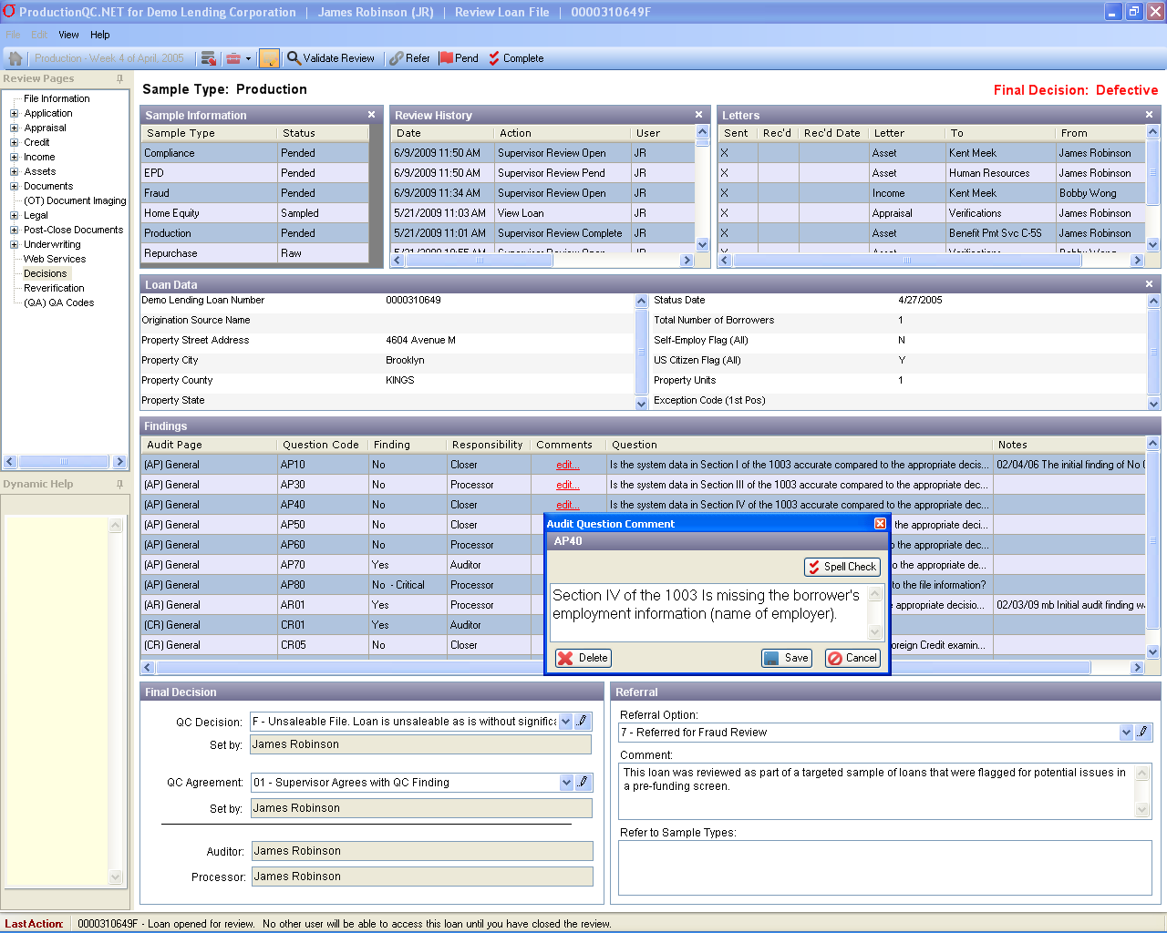
Audit Shells: Recording Audit Results
Notes:
Audit results are recorded in the Audit Shell, where reviewers are able to view the entire audit scope on a single screen, and efficiently proceed through their checklists, recording findings and comments as necessary.
The three panels at the top of the page display (1) the status of this loan in other review types (you can click on any other review to see its results), (2) the complete history of access to the loan in this review type, and (3) the status of letters.
The Audit Shell is designed to facilitate a supervisor review of the audit as well, with a separate page for recording supervisor findings and comments.
There is a separate tab for viewing Feedback responses – the responses from production or servicing operations – to the initial audit findings.
- At the conclusion of the review, the auditor or supervisor selects a final QC Decision. Each selection is translated into an overall rating of “acceptable” or “defective”. This enables you to report on high level defect rates, in addition to the detailed findings.

Slide 12
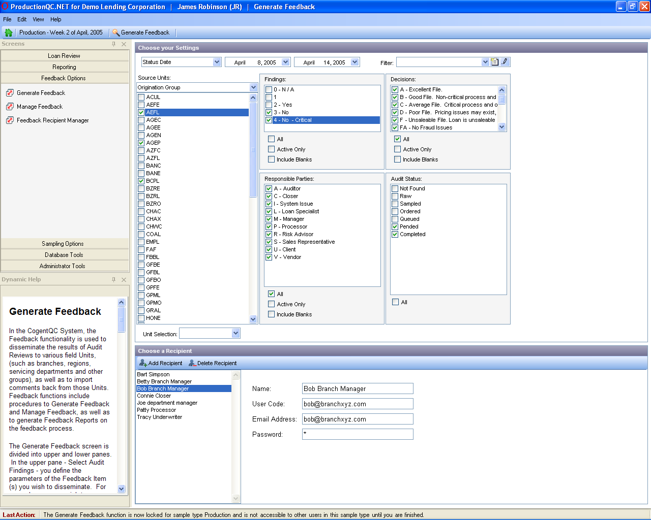
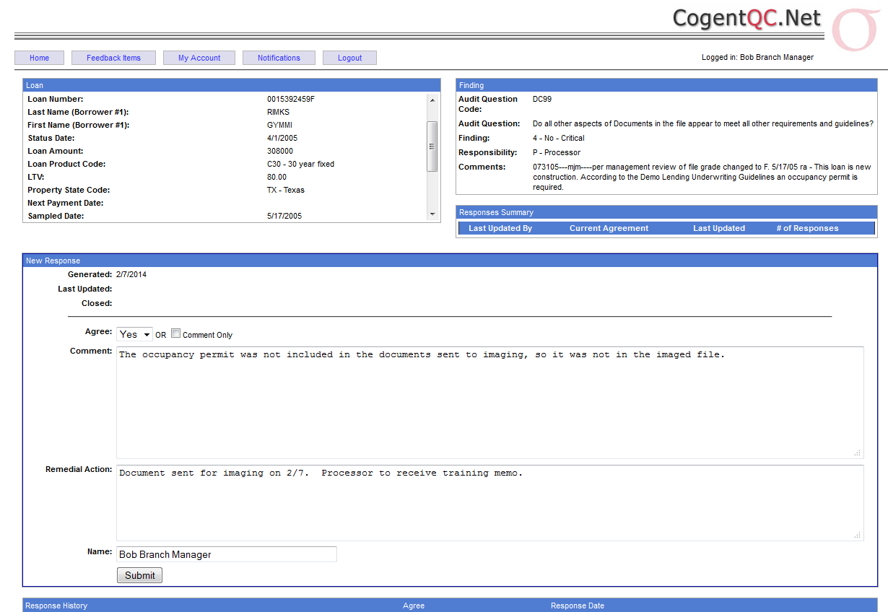
Feedback and Response Functionality
Completes the QC Process –Online!
Notes:
The back and forth process of sending out initial findings to the origination units or servicing departments for feedback can be an organizational nightmare. Cogent’s new online Feedback and Response functionality makes it simple.
A System Administrator selects the findings, selects one or more recipients, and sends a link via email. The recipient clicks on the link and goes to the internal website where the findings are displayed, then simply fills out the online form to respond.
Responses are immediately available in the System’s database, and users can view them, modify the initial findings as necessary, and then either close the item or ask for additional clarification. There is a standard set of Feedback Reports to show findings, responses and corrective actions – as well as the status of incomplete items.
- This functionality ensures that findings are verified, and that feedback and corrective actions are well documented.

Slide 13
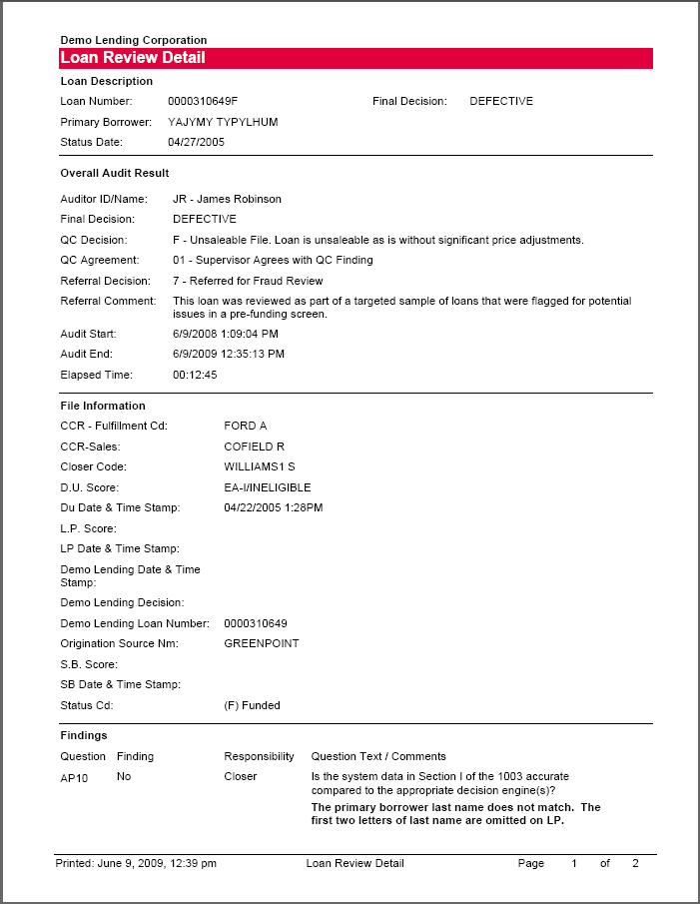
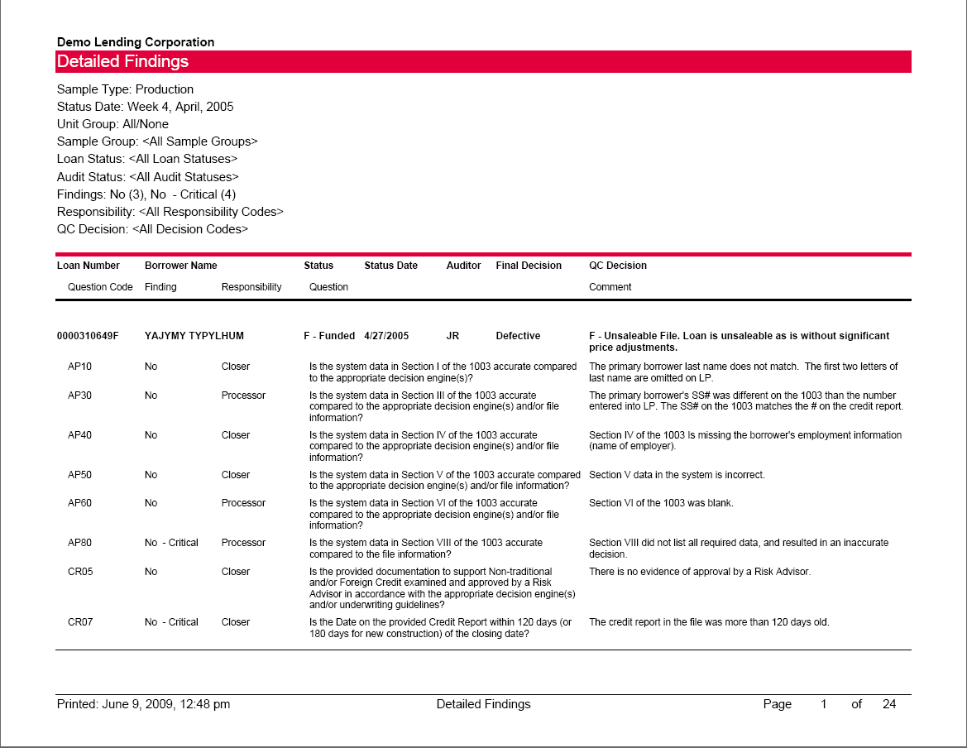
Detailed Findings Reports
A complete record of all findings, comments and responses...
Notes:
- In addition to the robust sampling and auditing, Cogent’s QC Systems are known for their extensive reporting capabilities.
- The Detailed Findings reports show all findings and comments, responsible parties, feedback responses, etc. for each individual loan review (Loan Review Detail) as well as roll ups of all the reviews over a specified time or from a specified source (Detailed Findings).
- Report parameters are chosen by the user to specify the data that you want to display, and then the selected data is pushed into the standard report format. You can preview the report instantly to decide if this is what you want or if you want to modify the parameters.

Slide 14
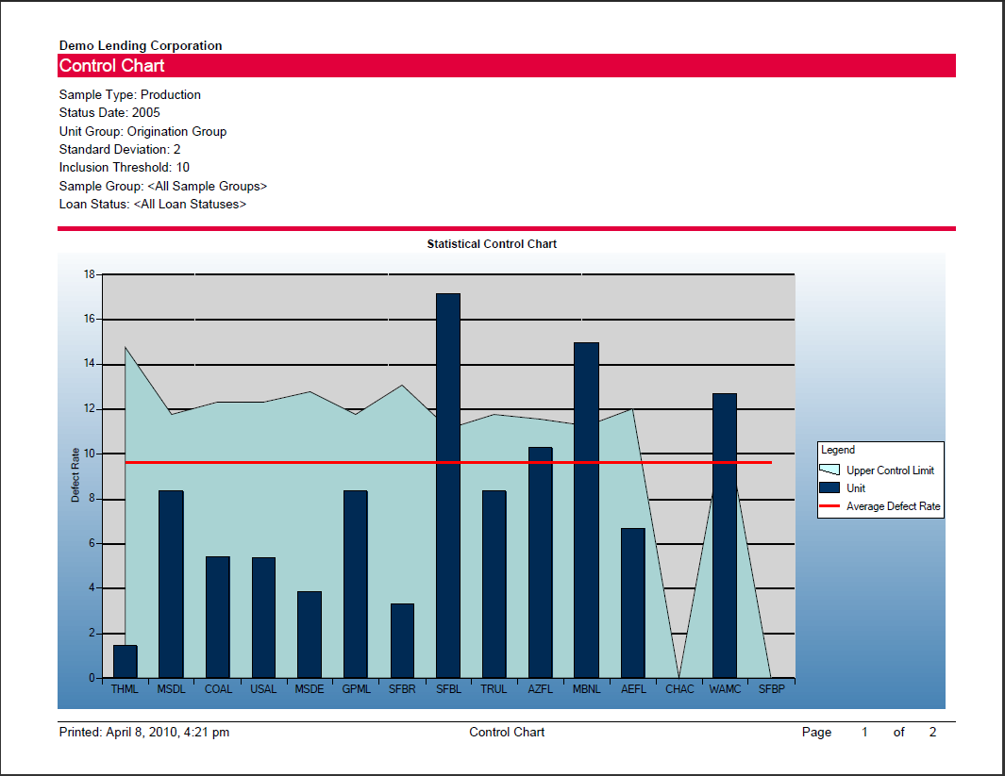
Management Reports Statistical Quality Trends and Comparisons
Notes:
The Management Reports are sophisticated (but easy to read) quality trend reports and comparative quality reports that allow you to identify spikes of poor quality and their sources. For example:
The Overall Loan Quality Report shows a 6-month quality trend for each review type, displaying the monthly defect rate (from your statistical sample) and the confidence interval.
The Control Chart displays a quality comparison of any units of origination or servicing that you want to compare, in order to identify “outliers” (those units that have a significantly higher defect rate than their peers).
- These reports cut through large amounts of data to give you concise and actionable information. They keep the focus on the percentages of loans that are defective – for whatever reason – so that you can accurately identify quality outliers and apply corrective action as necessary.

Slide 15
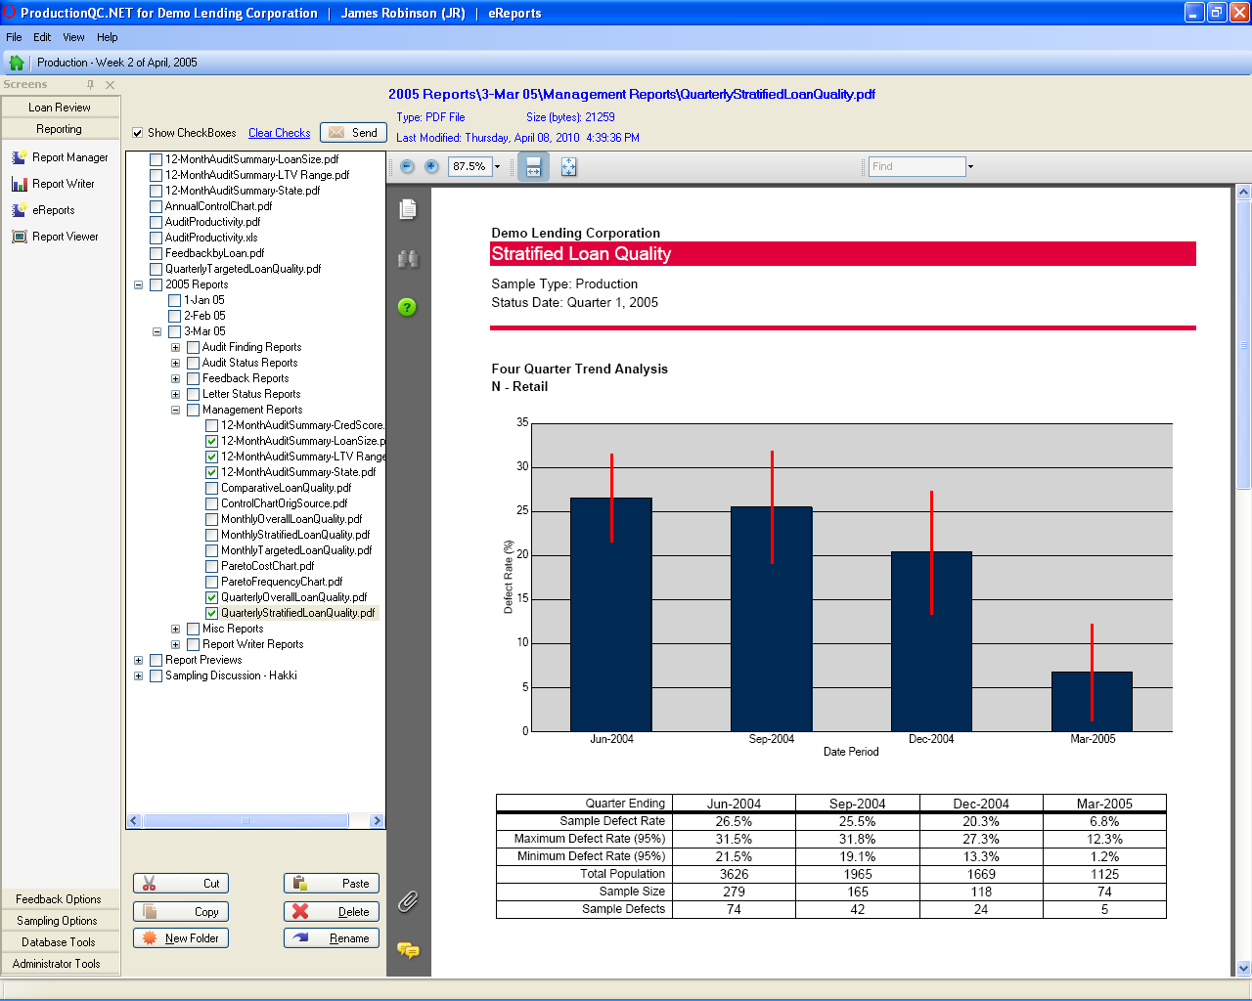
E-Reports Paperless Report Storage and Delivery
Notes:
- E-Reports allows you save and store all reports as PDF’s, providing a secure, centralized location for all your QC documentation. It’s easy to organize them however you wish – you create your own folder structure (usually by time frame, report type) – and they are easily retrievable as needed in the future.
- You can also open up your email program while in this interface, check off the reports or documents you want to send, and send them off electronically – increasing efficiency and saving trees!

Slide 16
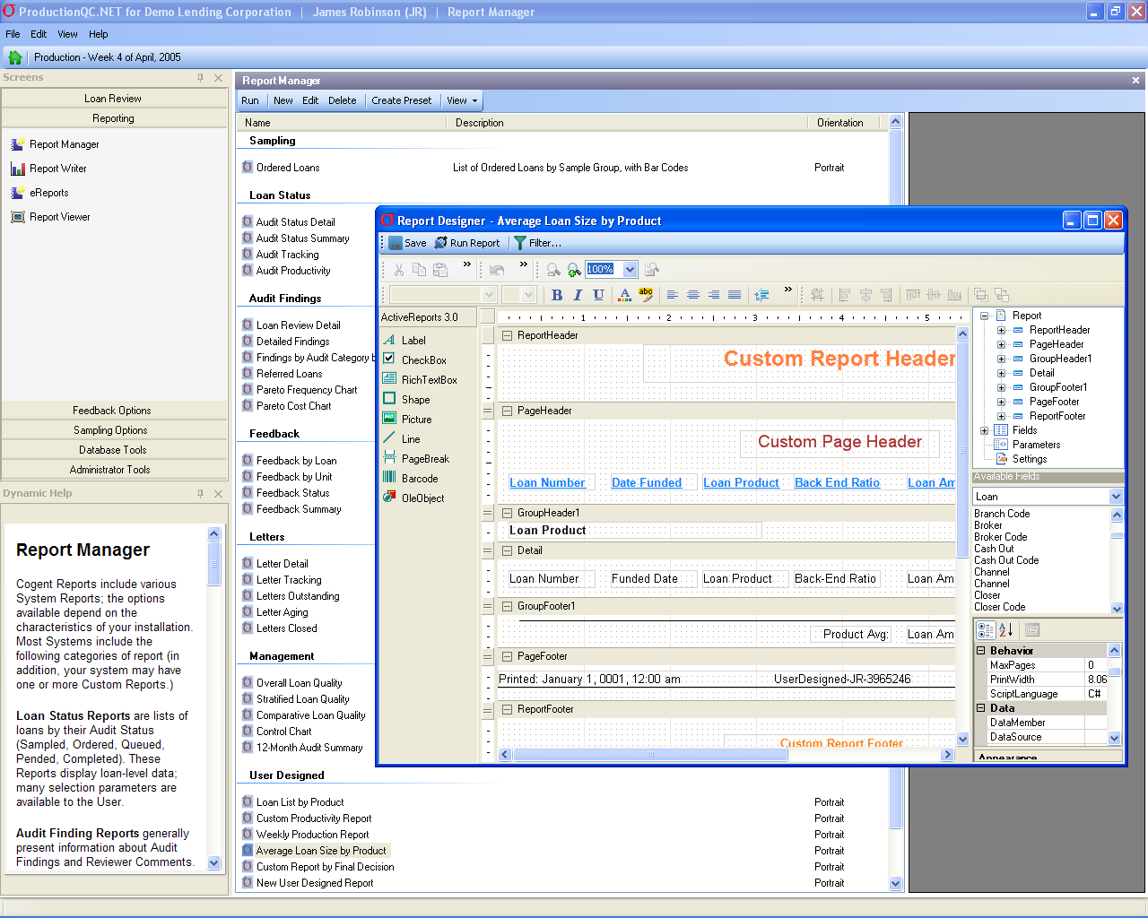
Optional Modules
Data Exchange
Appraisal Orders
Credit Reports
Compliance Checks
Fraud Checks
Specialized Worksheets
HUD1
Appraisal Review
Debt Ratio Calculator
Custom Functionality
By Client request
Notes:
- In addition to the extensive functionality that comes with the standard System, Cogent offers optional features and modules, such as: customized data exchange (for ordering and receiving appraisal reviews, credit reports and other services); and specialized worksheets for analyzing HUD 1’s, appraisal reviews and debt ratios.
- Cogent also does custom work for individual clients, and this is one way we come up with ideas for improvements that benefit all our clients.

Slide 17
Software and Hardware Specs
Software
Windows 2000 (or later) operating system (with .NET Framework, Version 2.0 or later installed)
The System is installed on a Windows 2000 (or later) server, and accessed via other W2K (or later) desktops.
If the System is to be used over a wide area network, Citrix server is recommended.
Microsoft SQL Server 2010, 2008, 2005, 2000
Microsoft IIS Ver. 6.x for hosting online feedback functions (optional)
Microsoft Outlook for automated emailing of reports (optional)
Hardware
Minimum Server Requirements:*
Pentium IV class or better PC with at least 1 GHz processor
1 GB RAM
10 GB of available hard disk space
* 3 core System components (application, database, web service) can be deployed across one or more servers
Minimum Workstation Requirements:
Pentium IV class or better PC with at least 500 MHz processor
512 MB RAM
1 GB of available hard disk space
Super VGA (1024 x 768) or higher screen resolution
Barcode scanner (optional)
Notes:
The software and hardware requirements are easily met by most companies -- basically a standard Windows, SQL Server environment.

Slide 18
Recap - Key Benefits
Unparalleled Functionality, Flexibility, Ease of Use
Data management, sampling, auditing, feedback, reporting,
configuration and content of audit shells, administrator tools
Expert Professional & Technical Support
Initial design & setup, free help desk, monthly webinars, custom
programming, continuous improvement, free upgrades
Improves Productivity of all QC staff
Translates into lower staffing costs and better coverage of risks
More Effective Quality Control
Minimizes random sampling, maximizes targeting, accelerates
feedback and response cycle, concise and actionable reports
Notes:
- By automating every aspect of the QC process, and making each more efficient, the Cogent System ensures that your auditors, processors and administrators are as productive as possible.
With Cogent’s superior technology and technical support, and our commitment to continuous improvement, you’ll know that as long as you are licensing a Cogent QC System, your audit teams will continue to have the best quality control tools and support available.
- More importantly, with more intelligent sampling, accelerated feedback and sophisticated reporting, your QC process will be more effective in identifying and reducing the instances and costs of poor quality.

